Slide 1
Programming, Data Science, and using it to have fun in the real world… :-)

Slide 2
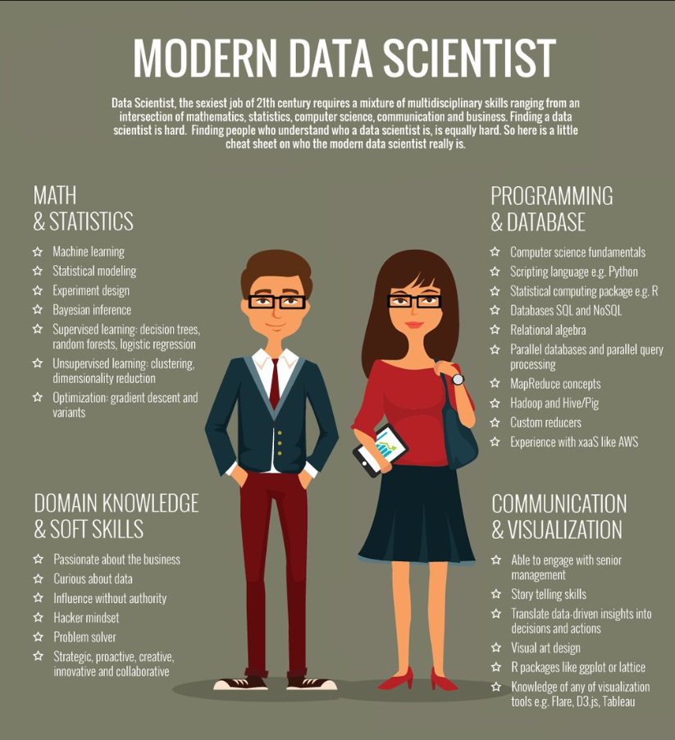
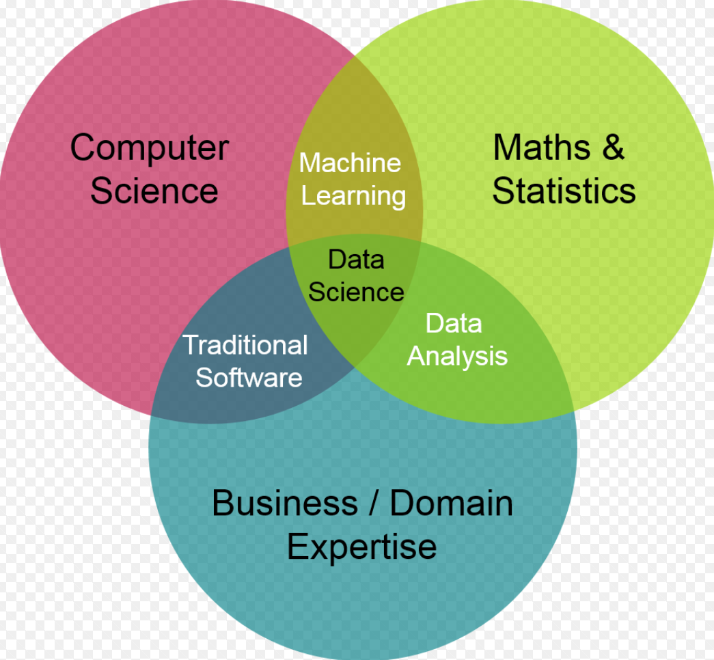
Who & What is a Data Scientist?

Slide 3
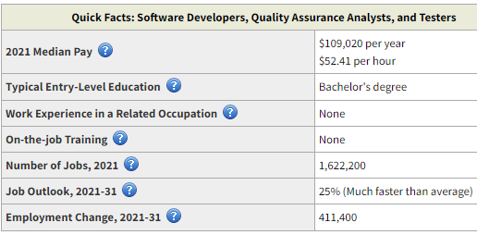
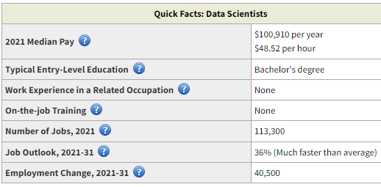
Job Outlook for Software Developers / Data Scientists
good
Spoiler alert…
US Bureau of Labor Statistics
https://www.bls.gov/ooh/computer-and-information-technology/software-developers.htm
https://www.bls.gov/ooh/math/data-scientists.htm

Slide 4







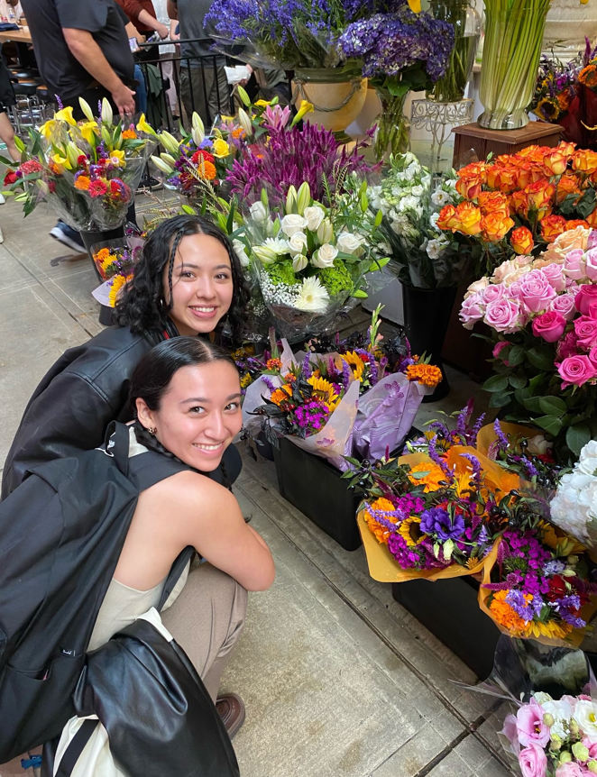
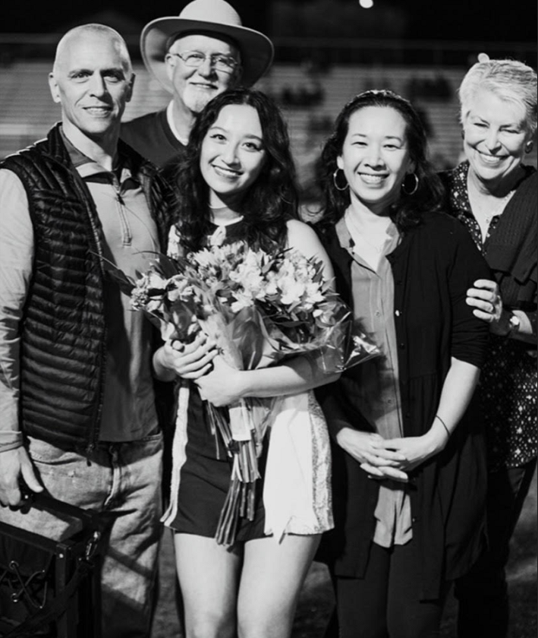
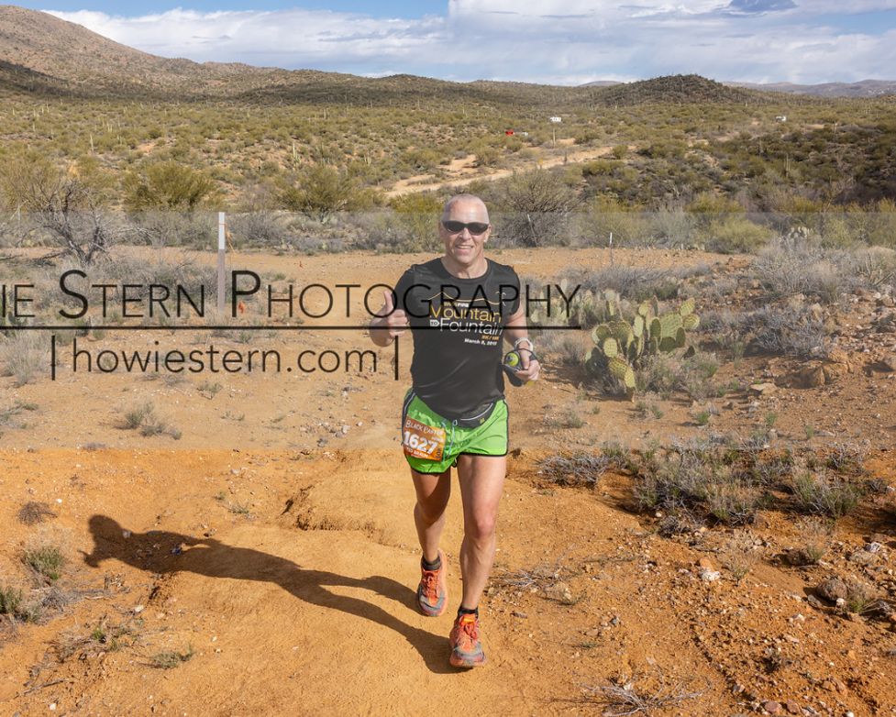
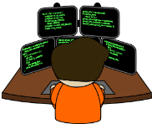
About Me (Ted)
School & Work:
Temple
Michigan State
Hobbies:
+
+
Running
Programming
Family

Slide 5
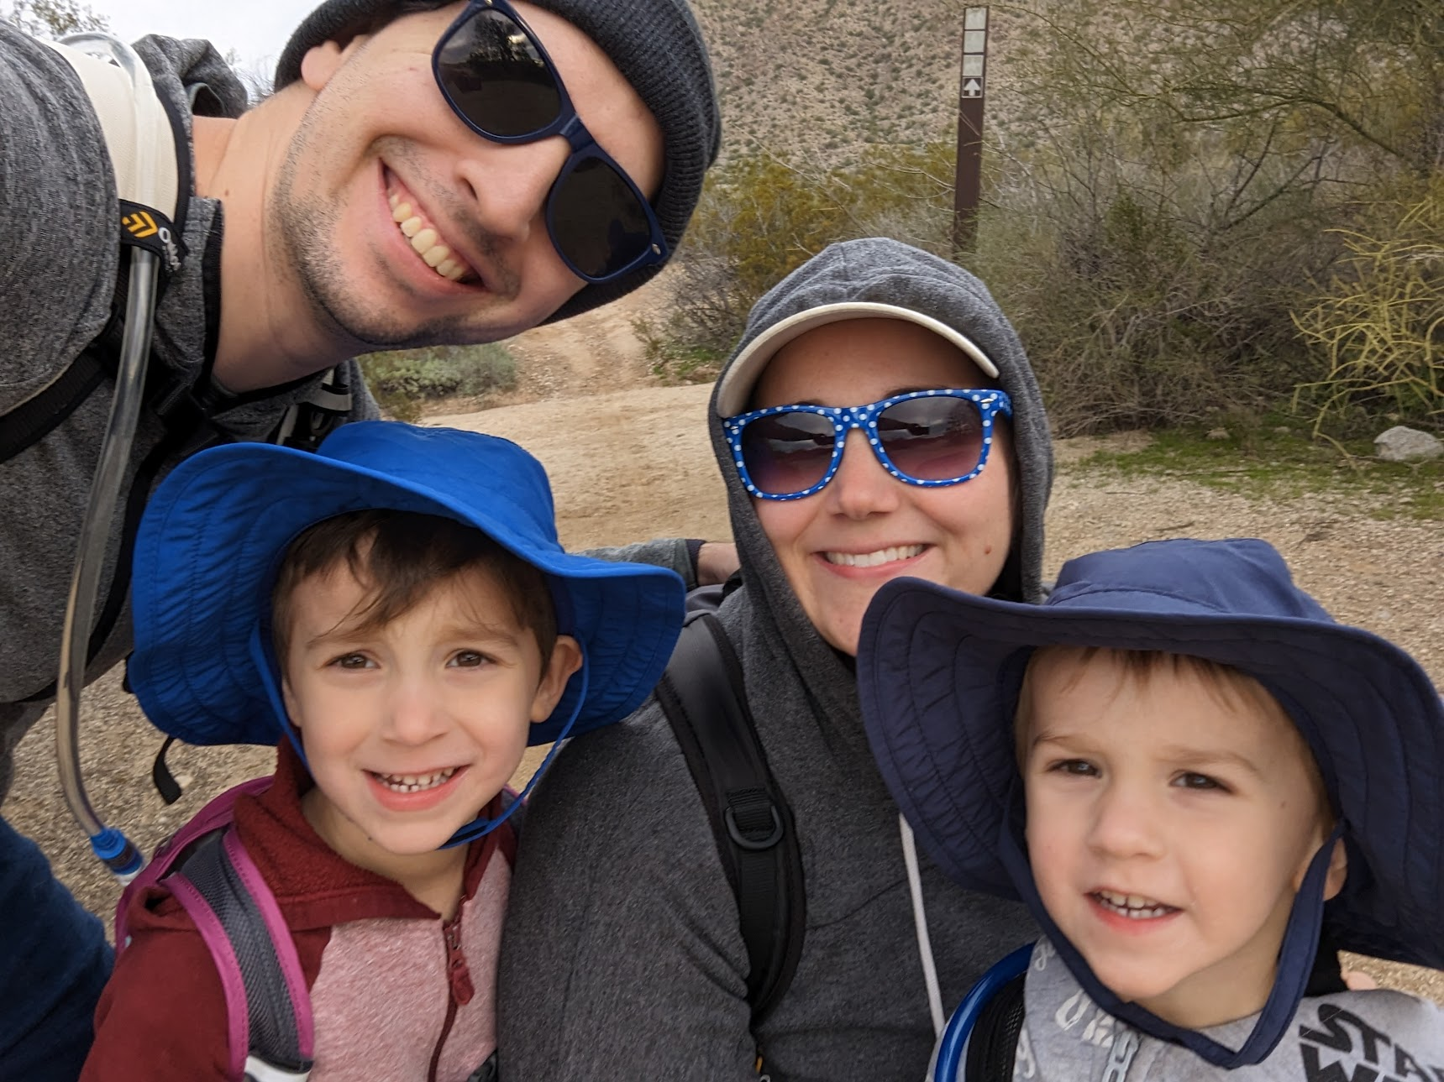

Matt Celaya
Graduated from MIT with a degree in Economics
Worked at ON Semiconductor as a data scientist
Currently working at Intel as a supply chain technical analyst
Python, R, Javascript, SQL
I enjoy reading, chess, guitar, hiking, and gaming

Slide 6
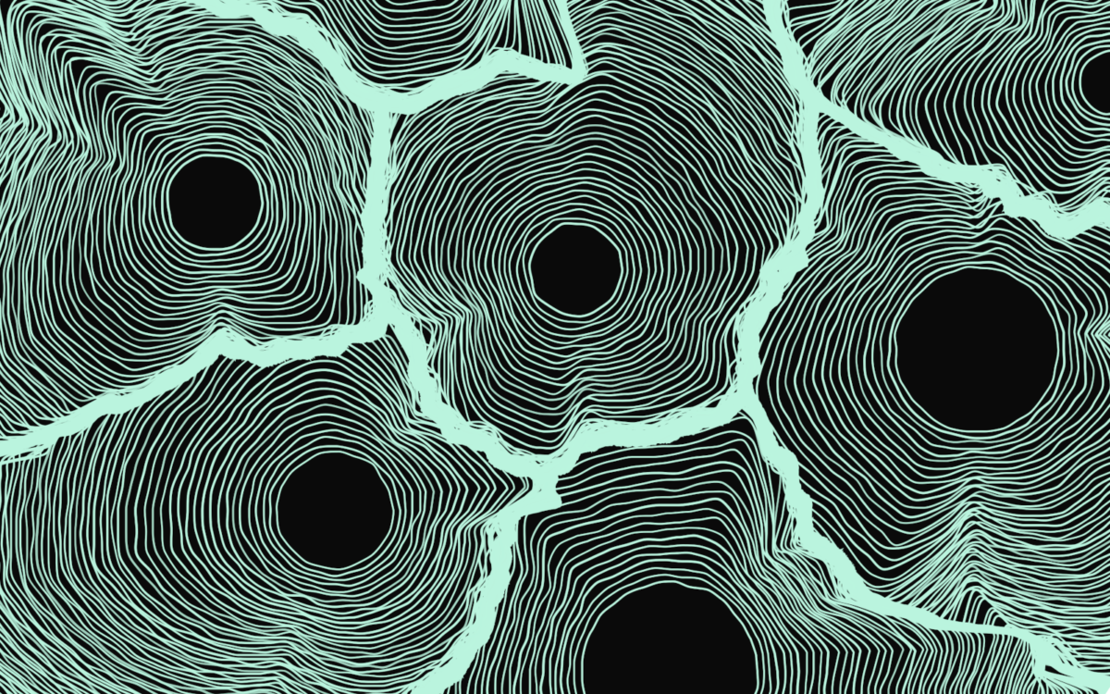
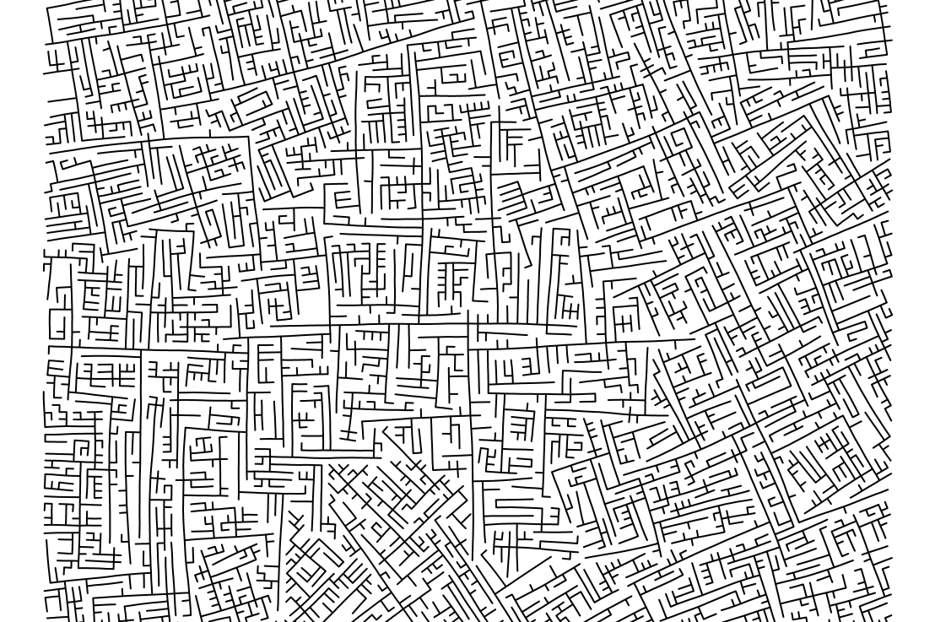
Programming for Creativity
There’s a wide range of interesting applications of programming outside of business or academic spaces
Lots of people use programming to express their creativity
Generative art
AI generated images and text
Data viz
Games!
What are some creative projects you’re interested in working on?

Slide 7
Tips for creative coding
Work on projects that interest you
Understand your own skill-level and set reasonable expectations in deciding on what to build (you don’t need to build the next ChatGPT!)
Don’t limit yourself to one language or technology
Try to understand concepts and patterns you can apply to any language or project
Have fun! It’s cliché but it’s true.

Slide 8
Examples
https://mc-markov.surge.sh/
https://mc-sir-model.glitch.me/
https://mc-tree-generator.glitch.me/
https://mc-pixel-paint.glitch.me/
https://mc-maze-generator.glitch.me/

Slide 9

Exploring Data – Prison Statistics
Things I like to do with programming (outside of work, and really inside as well )…
Find something fun that you want to try to technically accomplish, and match it up with data which you can use to accomplish it.
In this case I wanted to draw a choropleth map which moved over time, and then find data to use to accomplish it.
So… lets play
The stuff I am presenting is posted here: https://github.com/TedBraun08/fun
This presentation: https://github.com/TedBraun08/fun/blob/main/DV_Slides_May_2023.pptx Program: https://github.com/TedBraun08/fun/blob/main/PrisonStats_and_Corr.r Output #1: https://github.com/TedBraun08/fun/blob/main/az.png
Output #2: https://github.com/TedBraun08/fun/blob/main/PrisonAdmitPer100k_02.gif Output #3: https://github.com/TedBraun08/fun/blob/main/States_10.gif
Output #4: https://github.com/TedBraun08/fun/blob/main/CorrelationMatrix_01.gif

